Slide 1
Unit-3
Oops through java

Slide 2
Declaration and Initialization of Arrays
Declaration of an Array
When you declare an array, you tell Java what type of data it will hold and how to refer to it.
Syntax:
dataType[] arrayName; // Preferred way dataType arrayName[]; // Also valid, but less common

Slide 3
examples
int[] numbers; // Array of integers
String[] names; // Array of Strings
double[] prices; // Array of doubles

Slide 4
Initialization of an Array
There are two main ways to initialize an array.

Slide 5
(A) Separate Declaration and Initialization
int[] arr = new int[3];
arr[0] = 10;
arr[1] = 20;
arr[2] = 30;

Slide 6
(B) Declaration with Initialization (Static Initialization)
When you already know the values:
int[] numbers = {10, 20, 30, 40, 50};
String[] names = {"Alice", "Bob", "Charlie"};
The size is automatically determined by the number of elements.

Slide 7
2.Storage of Array in Computer Memory
Array in Java is an object, so it’s stored in heap memory.
Array name (refe--rence) is stored in stack memory.
Elements are stored one after another (contiguous) in the heap.

Slide 8
Example:
int[] arr = {10, 20, 30};
Stack: arr → points to heap
Heap: [10] [20] [30] (continuous blocks)

Slide 9
3.Accessing Elements of Arrays
When you create an array in Java, its elements are stored in indexed positions starting from 0 (first element) up to length - 1 (last element).
You can access any element by using its index with the array name.

Slide 10
Syntax
arrayName[index];
arrayName → Name of the array.
index → Position of the element (starts from 0).

Slide 11
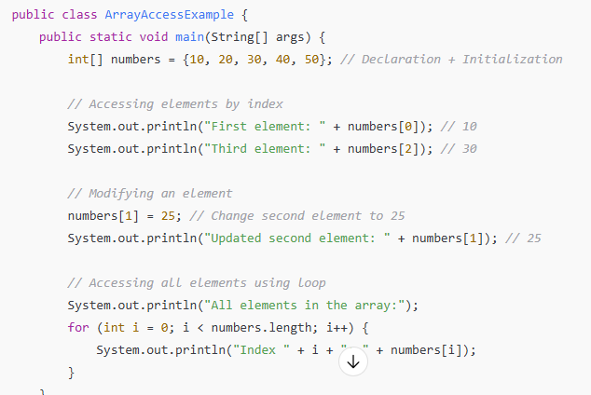
Example

Slide 12
4.Operations on Array Elements
Traversal → Visiting each element one by one.
Insertion → Adding a new element at a specific position.
Deletion → Removing an element from a specific position.
Searching → Finding the position of an element.
Updation → Changing the value of an element.
Sorting → Arranging elements in order (ascending/descending).
Reversing → Changing the order of elements to opposite.
Mathematical operations → Like sum, average, min, max, etc.

Slide 13
5.Assigning Array to Another Array
In Java, assigning one array to another doesn’t create a new copy of the array’s elements — it simply makes both variables refer to the same array object in memory.

Slide 14
Example
public class AssignArrayExample {
public static void main(String[] args) {
int[] arr1 = {10, 20, 30};
int[] arr2 = arr1; // Both refer to the same array
arr2[1] = 99; // Change through arr2
System.out.println("arr1[1]: " + arr1[1]); // 99 — change reflects in arr1
System.out.println("arr2[1]: " + arr2[1]); // 99
}
}

Slide 15
Explanation
arr2 = arr1; means no new array is created.
Both variables point to the same memory location.
Modifying one array’s element changes it for the other.

Slide 16
6. Dynamic Change of Array Size
In Java, arrays have a fixed size once created — you cannot directly increase or decrease their length.
If you want to dynamically change an array’s size, you have to:
Create a new array of the desired size.
Copy the old array’s elements into the new array.

Slide 17
Example: Manually increasing array size
public class DynamicArraySize {
public static void main(String[] args) {
int[] arr = {1, 2, 3};
System.out.println("Original array:");
for (int num : arr) {
System.out.print(num + " ");
}
// Increase size from 3 to 5
int newSize = 5;
int[] newArr = new int[newSize];

Slide 18
Example
// Copy old elements
for (int i = 0; i < arr.length; i++) {
newArr[i] = arr[i];
}
// Add new elements
newArr[3] = 4;
newArr[4] = 5;
System.out.println("\nNew array:");
for (int num : newArr) {
System.out.print(num + " ");
}
}
}

Slide 19
7.Sorting of
Arrays
Sorting of Arrays in Java means arranging the elements of an array in a specific order, usually ascending (smallest to largest) or descending (largest to smallest).

Slide 20
Types of Sorting
Ascending Order → Smallest to Largest
Example: [5, 2, 9, 1] → [1, 2, 5, 9]
Descending Order → Largest to Smallest
Example: [5, 2, 9, 1] → [9, 5, 2, 1]

Slide 21
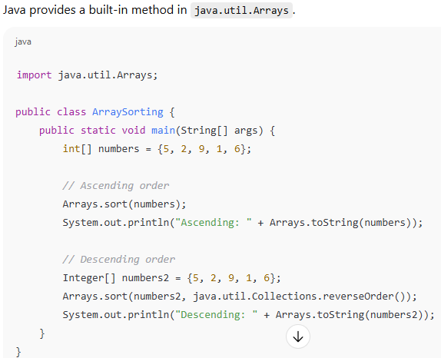
1. Using Arrays.sort()

Slide 22
Manual Sorting (Algorithms)
You can also implement sorting yourself:
Bubble Sort
Selection Sort
Insertion Sort
Merge Sort
Quick Sort

Slide 23
8.Search for Values in Arrays
Searching for values in arrays means checking whether a given element exists in the array and, if so, finding its position (index).
There are mainly two types of searching techniques used in arrays:

Slide 24
1. Linear Search
Works on unsorted or sorted arrays.
Checks each element one by one until the value is found.
Time Complexity → O(n)

Slide 25
2. Binary Search
Works only on sorted arrays.
Repeatedly divides the array into halves.
Time Complexity → O(log n)

Slide 26
9.Class Arrays
In Java, the Arrays class is a utility class present in the java.util package.
It provides static methods to perform operations on arrays such as sorting, searching, comparing, filling, and converting arrays to strings or lists.

Slide 27
Features of Arrays class:
Belongs to java.util package.
Contains only static methods.
Supports operations like sort, search, fill, copy, compare, equals, and toString.

Slide 28
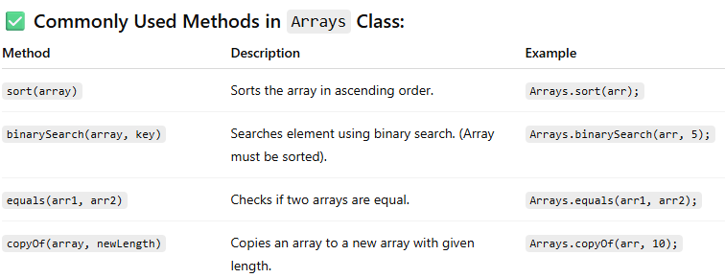
Commonly Used Methods in Arrays Class:

Slide 29
10. Two-dimensiona1 Arrays
A two-dimensional (2D) array is an array of arrays.
It can be visualized as a table with rows and columns, where data is stored in row-column form.

Slide 30
Declaration of 2D Array
dataType[][] arrayName;
Creation of 2D Array
int[][] arr = new int[3][4]; // 3 rows and 4 columns
Here:
arr is a 2D array of integers.
It has 3 rows and 4 columns.

Slide 31
1.Initialization of 2D Array
int[][] arr = {
{1, 2, 3},
{4, 5, 6},
{7, 8, 9}
};

Slide 32
2. Dynamic Initialization
int[][] arr = new int[2][3];
arr[0][0] = 10;
arr[0][1] = 20;
arr[0][2]=50;
arr[1][0] = 30;
arr[1][1] = 40;
arr[1][2]=60;

Slide 33
Accessing Elements in 2D Array
System.out.println(arr[1][2]);

Slide 34
Traversing a 2D Array
for (int i = 0; i < arr.length; i++) { // rows
for (int j = 0; j < arr[i].length; j++) { // columns
System.out.print(arr[i][j] + " ");
}
System.out.println();
}

Slide 35
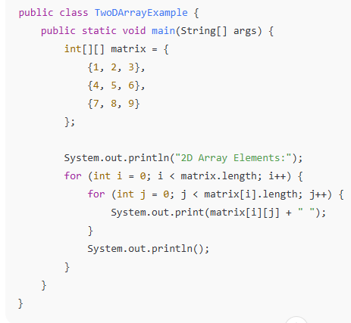
Example Program

Slide 36
11. Arrays of Varying Lengths
In Java, arrays of varying lengths usually refer to jagged arrays (also called ragged arrays).
Unlike a regular 2D array (which has rows and columns of equal length), a jagged array allows each row to have a different number of elements.

Slide 37
Declaration of Jagged Array
int[][] arr = new int[3][];
Here, arr is a 2D array with 3 rows.
The columns are not defined yet.

Slide 38
Initialization of Jagged Array
You can initialize rows with different lengths:
arr[0] = new int[2]; // 1st row has 2 elements
arr[1] = new int[4]; // 2nd row has 4 elements
arr[2] = new int[3]; // 3rd row has 3 elements

Slide 39
Example: Arrays of Varying Lengths
public class JaggedArrayExample {
public static void main(String[] args) {
// Create a jagged array
int[][] arr = new int[3][];
// Initializing with varying lengths
arr[0] = new int[2];
arr[1] = new int[4];
arr[2] = new int[3];

Slide 40
Example
// Assigning values
int value = 1;
for (int i = 0; i < arr.length; i++) {
for (int j = 0; j < arr[i].length; j++) {
arr[i][j] = value++;
}
}
// Printing jagged array
for (int i = 0; i < arr.length; i++) {
for (int j = 0; j < arr[i].length; j++) {
System.out.print(arr[i][j] + " ");
}
System.out.println();
}
}
}

Slide 41
12. Three-dimensional
Arrays
A three-dimensional (3D) array in Java is simply an array of two-dimensional arrays.
It can be visualized like a cube (or a stack of 2D matrices).

Slide 42
Declaration of 3D Arrays
dataType[][][] arrayName = new dataType[size1][size2][size3];
size1 → Number of 2D arrays (depth).
size2 → Number of rows in each 2D array.
size3 → Number of columns in each row.

Slide 43
Example: Declaring and Initializing
public class ThreeDArrayExample {
public static void main(String[] args) {
// 3D array with 2 blocks, 3 rows, 4 columns
int[][][] arr = new int[2][3][4];
// Assigning values
int count = 1;
for (int i = 0; i < 2; i++) { // block
for (int j = 0; j < 3; j++) { // row
for (int k = 0; k < 4; k++) { // column
arr[i][j][k] = count++;
}
}
}

Slide 44
example
// Printing values
for (int i = 0; i < 2; i++) {
System.out.println("Block " + (i + 1) + ":");
for (int j = 0; j < 3; j++) {
for (int k = 0; k < 4; k++) {
System.out.print(arr[i][j][k] + " ");
}
System.out.println();
}
System.out.println();
}
}
}

Slide 45
13.Arrays as Vectors
In mathematics, a vector is an ordered collection of elements (like numbers) that can represent points, directions, or magnitudes.
In programming, especially in Java, an array can be treated like a vector, because:
  It stores elements of the same type.
  The elements are stored in contiguous memory.
  Each element can be accessed using an index.

Slide 46
Example: Array as Vector
class ArrayAsVector {
public static void main(String[] args) {
// Declaring an array (like a vector of 5 integers)
int vector[] = {10, 20, 30, 40, 50};
// Accessing elements
System.out.println("First element: " + vector[0]);
// Performing vector-like operations
int sum = 0;
for (int i = 0; i < vector.length; i++) {
sum += vector[i];
}
System.out.println("Sum of vector elements: " + sum);
}
}

Slide 47
explanation
Here, the vector array behaves like a mathematical vector of size 5.
You can perform operations such as addition, subtraction, dot product, scalar multiplication using arrays.

Slide 48
1.Inheritance
Definition
Inheritance in Java is a mechanism where one class acquires the fields (variables) and methods of another class.

Slide 49
Uses
Code reusability – Avoid writing the same code multiple times.
Method Overriding – To achieve runtime polymorphism.
Extensibility – Create new features on top of existing classes.

Slide 50
Process of Inheritance in Java
The process of inheritance describes how one class (child/subclass) acquires the properties and behavior of another class (parent/superclass).

Slide 51
Process of Inheritance in Java
1. Define a Parent Class (Super Class)
Create a class that contains common fields and methods.
This class will be inherited by another class.

Slide 52
Process of Inheritance in Java
class Parent {
int a = 10;
void display() {
System.out.println("This is Parent class");
}
}

Slide 53
2.Process of Inheritance in Java
2. Create a Child Class (Sub Class) using extends
Use the extends keyword to make one class inherit another.
The child class gets access to all non-private members of the parent.

Slide 54
Process of Inheritance in Java
class Child extends Parent {
void show() {
System.out.println("This is Child class");
}
}

Slide 55
Process of Inheritance in Java
3. Create an Object of Child Class
When we create an object of the child class:
  The constructor of the parent class executes first (using super() implicitly).
  Then the child class constructor executes.
The object can use both parent and child methods.

Slide 56
Process of Inheritance in Java
public class InheritanceProcess {
public static void main(String[] args) {
Child obj = new Child();
obj.display(); // Parent class method
obj.show(); // Child class method
}
}

Slide 57
Process of Inheritance in Java
Output:
This is Parent class
This is Child class

Slide 58
Process of Inheritance in Java
4. Accessing Members
The child class object can access:
✅ All public and protected members of parent.
❌ Cannot access private members directly.

Slide 59
Process of Inheritance in Java
Inheritance Process (Step by Step Flow)
Write parent class.
Write child class using extends.
Create object of child class.
Parent’s members are available in child class object.
Constructors execute in order: Parent → Child.

Slide 60
3.Types of Inheritance in Java
java supports different types of inheritance. However, multiple inheritance with classes is not supported (to avoid ambiguity), but it is supported through interfaces.

Slide 61
Types of Inheritance in Java
Single Inheritance – One child inherits one parent.
Multilevel Inheritance – A class inherits another class, which is also inherited by another.
Hierarchical Inheritance – Multiple child classes inherit the same parent.
Multiple Inheritance (via Interfaces only).

Slide 62
Single Inheritance
A class inherits from only one parent class.

Slide 63
Multilevel Inheritance
A class is derived from another class, which is also derived from another class.

Slide 64
Hierarchical Inheritance
Multiple child classes inherit from the same parent class.

Slide 65
Multiple Inheritance (via Interfaces only)
Java does not support multiple inheritance with classes (to avoid the diamond problem).
But, it supports multiple inheritance using interfaces.

Slide 66
4.Universal Super Class-Object Class
In Java, Object class (defined in java.lang package) is the superclass of all classes.
Every class in Java implicitly inherits the Object class (directly or indirectly).
If a class does not extend any other class, it automatically extends Object.

Slide 67
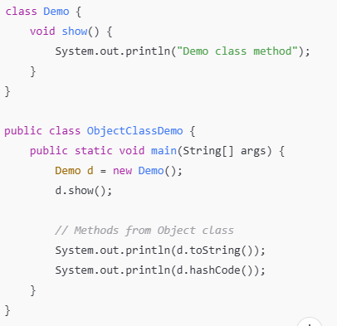
Universal Super Class-Object Class

Slide 68
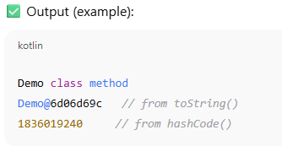
Universal Super Class-Object Class

Slide 69
Universal Super Class-Object Class
Important Methods of Object Class
The Object class provides several methods, which every class in Java inherits.

Slide 70
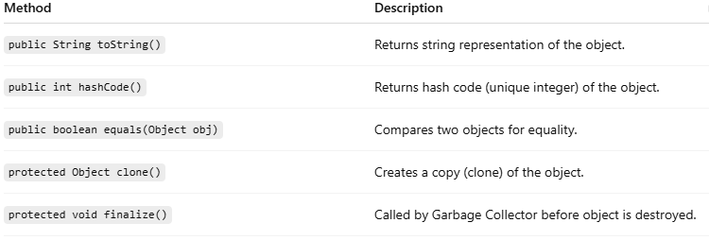
Universal Super Class-Object Class

Slide 71
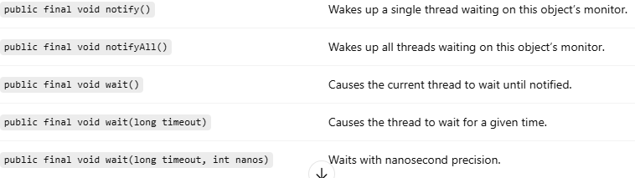
Universal Super Class-Object Class

Slide 72
5. Inhibiting Inheritance of Class Using Final
In Java, the final keyword is used to restrict usage.
When a class is declared as final, it cannot be inherited.

Slide 73
Inhibiting Inheritance of Class Using Final
Example of a Final Class in Java
Some classes in Java are declared final to maintain security and consistency.
For example:
java.lang.String class is final → ensures immutability.
java.lang.Math class is final.

Slide 74
Why Use Final Classes?
Security → Prevents altering critical classes (like String).
Immutability → Ensures object state does not change (important in multithreading).
Design choice → Stops unwanted inheritance where extension is not meaningful.

Slide 75
6. Access Control and Inheritance
Access Control in Java
Access control is defined using access specifiers (modifiers).
They determine which members (fields/methods) of a class can be inherited and accessed by subclasses.
Access Specifiers in Java:
private – Accessible only within the same class.
default (no modifier) – Accessible within the same package.
protected – Accessible within the same package and in subclasses (even if they are in different packages).
public – Accessible everywhere

Slide 76
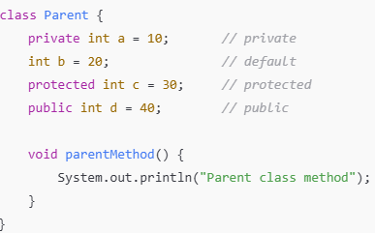
Example: Access Control with Inheritance

Slide 77
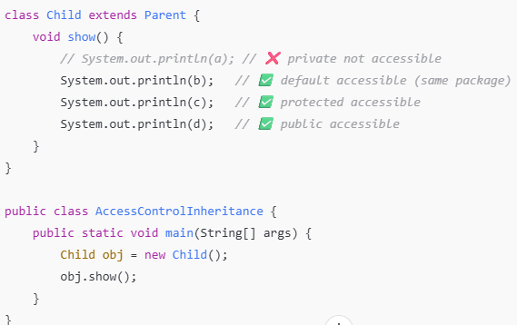
Example: Access Control with Inheritance

Slide 78
Example: Access Control with Inheritance
Output:
20 30 40

Slide 79
Example: Access Control with Inheritance
Important Notes
Private members are not inherited at all.
Default members are inherited only within the same package.
Protected members are inherited and accessible in subclasses even if they are in a different package (but only through inheritance).
Public members are inherited everywhere.

Slide 80
7. Multilevel Inheritance
Multilevel Inheritance means a class is derived from another class, which is also derived from another class.
Like a chain of inheritance (Grandparent → Parent → Child).
Each subclass inherits the properties and methods of its immediate parent, and indirectly from all its ancestors.

Slide 81
8. Application of Keyword Super
What is super?
super is a reference variable in Java that refers to the immediate parent class object.
It is mainly used to access parent class members (fields, methods, constructors) when they are hidden/overridden in the child class.

Slide 82
8. Application of Keyword Super
Summary of super keyword Applications
Access parent class variable → when hidden by child variable.
Access parent class method → when overridden in child class.
Access parent class constructor → using super() inside child constructor.

Slide 83
9. Constructor Method and Inheritance
When inheritance comes into play:
Constructors are not inherited.
But when a subclass object is created, the superclass constructor is always executed first, then the subclass constructor.

Slide 84
Constructor Method and Inheritance
Rules:
By default, the subclass constructor calls the no-argument constructor of the superclass using super().
If the superclass does not have a no-argument constructor, then the subclass must explicitly call one of the superclass constructors using super(parameters).
If you don’t write super(), the compiler adds it automatically (only for no-arg).
super() must always be the first statement in a constructor.

Slide 85
10. Dynamic Method Dispatch
Dynamic Method Dispatch (also called Runtime Polymorphism) is the process by which a method call to an overridden method is resolved at runtime, not at compile time.
It allows Java to decide which version of the method (parent’s or child’s) to execute based on the object being referred to, not the reference type.

Slide 86
10. Dynamic Method Dispatch
Key Points
It works only with method overriding (not method overloading).
A superclass reference variable can refer to a subclass object.
The method call is resolved at runtime, depending on the object type.
Provides run-time polymorphism in Java.

Slide 87
11. Abstract Classes
What is an Abstract Class?
An abstract class in Java is a class declared with the keyword abstract.
It cannot be instantiated (objects can’t be created directly).
It is used to provide a base for other classes to extend and implement its abstract methods.

Slide 88
Abstract Classes
Abstract Methods
An abstract method is a method declared without implementation (no body).
Subclasses must override and implement abstract methods.
Declared using abstract keyword.
if a class contains at least one abstract method, the class itself must be declared abstract.

Slide 89
12. Interfaces and Inheritance
Interfaces in Java
An interface is a blueprint of a class that contains only:
  Abstract methods (till Java 7),
  Default & static methods (Java 8+),
  Private methods (Java 9+).
By default, all methods in an interface are public and abstract (except default, static, and private).
Variables in an interface are implicitly:
  public static final (constants).
interfaces support multiple inheritance in Java (since a class can implement multiple interfaces).

Slide 90
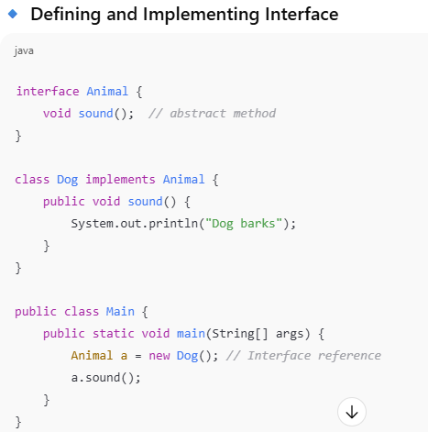
12. Interfaces and Inheritance

Slide 91
Interface introduction
Declared using the interface keyword.
All methods inside an interface are public and abstract by default.
Variables in an interface are public, static, and final by default.

Slide 92
Interface introduction
A class can implement multiple interfaces (achieving multiple inheritance).
From Java 8 onwards: Interfaces can also contain default and static methods with body.
From Java 9 onwards: Interfaces can have private methods as well.

Slide 93
Declaration of Interface
Declaration of Interface
In Java, an interface is declared using the interface keyword.

Slide 94
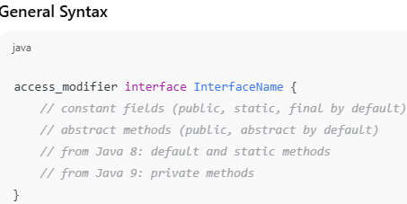
Declaration of Interface

Slide 95
Declaration of Interface
Key Notes about Declaration
No constructor allowed.
Methods are abstract by default (unless declared default or static).
Variables are public static final by default.
Interface cannot be instantiated (no new InterfaceName()), only implemented.

Slide 96
Implementation of Interface
Once an interface is declared, a class must provide definitions (implementations) for all abstract methods of that interface using the implements keyword.

Slide 97
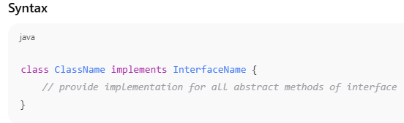
Implementation of Interface

Slide 98
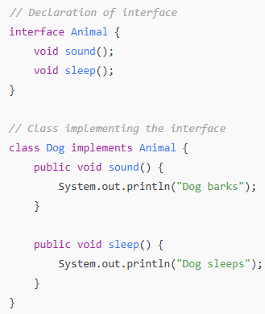
Implementation of Interface

Slide 99
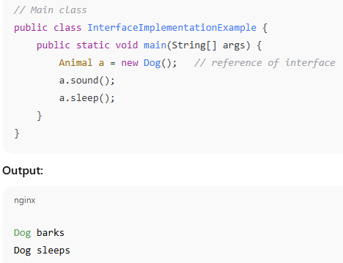
Implementation of Interface

Slide 100
Multiple Interfaces
Java does not support multiple inheritance with classes (a class can’t extend two classes),
but it does support multiple inheritance using interfaces.

Slide 101
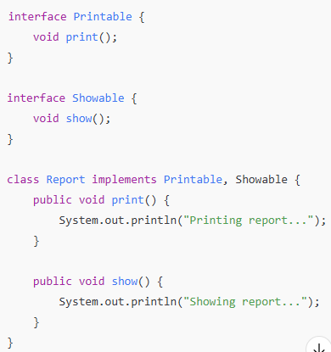
Multiple Interfaces

Slide 102
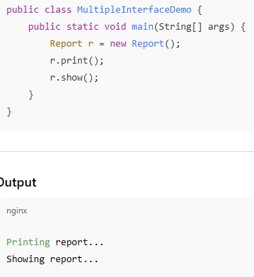
Multiple Interfaces

Slide 103
Nested Interfaces
A nested interface is an interface declared inside a class or another interface.
It is also called an inner interface.

Slide 104
Nested Interfaces
Rules
An interface can be declared inside a class or another interface.
If nested inside a class, it can be declared public, private, or protected.
If nested inside an interface, it is always public (implicitly).

Slide 105
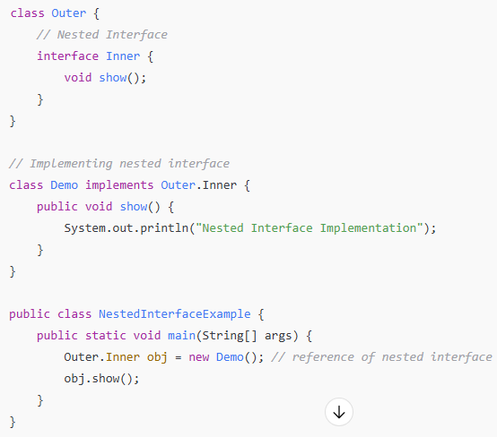
Nested Interfaces

Slide 106
Inheritance of Interfaces
Just like classes, interfaces in Java can also inherit from other interfaces using the extends keyword.
But unlike classes, an interface can extend multiple interfaces at the same time (supports multiple inheritance).

Slide 107
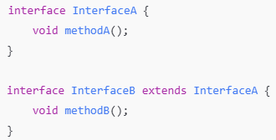
Inheritance of Interfaces

Slide 108
Inheritance of Interfaces
InterfaceB inherits from InterfaceA.
Any class that implements InterfaceB must provide implementation for both methodA() and methodB().

Slide 109
Default Methods in Interfaces
Before Java 8, all methods in an interface were abstract (no body).
From Java 8 onwards, interfaces can also have default methods — methods with a body (implementation).

Slide 110
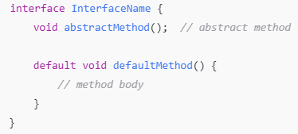
Default Methods m Interfaces

Slide 111
Static Methods in Interface
Before Java 8, interfaces could only have abstract methods (and constants).
From Java 8 onwards, interfaces can also have static methods — methods with a body that belong to the interface itself, not to the implementing classes.

Slide 112
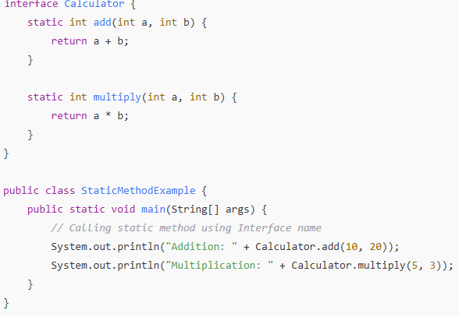
Static Methods in Interface

Slide 113
Functional Interfaces
A Functional Interface is an interface that contains exactly one abstract method.
It can have any number of default and static methods.
Marked with the @FunctionalInterface annotation (optional, but recommended).

Slide 114
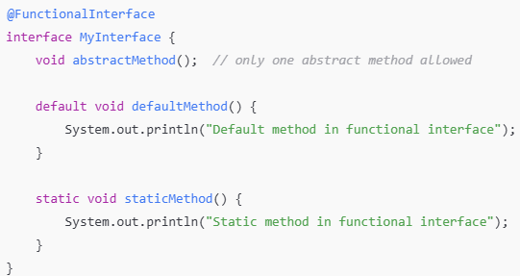
Functional Interfaces

Slide 115
Annotations
An annotation is a special kind of metadata (information) that provides data about a program but is not part of the program logic.
They are used by compiler, tools, or runtime environments to understand additional instructions about the code.
Introduced in Java 5.
Defined using the symbol @ before the annotation name.

Slide 116
Annotations
1. Built-in Annotations (Predefined)
These are provided by Java itself.
@Override → Checks if a method is actually overriding a parent class method.
@Deprecated → Marks method/class as deprecated (not recommended to use).
@SuppressWarnings → Instructs compiler to ignore specific warnings.

